Slide 1
Leftover Patterns
CS350, Spring 2012

Slide 2
Creational Patterns
Abstract Factory
Builder
Factory Method
Prototype
Singleton

Slide 3
Structural Patterns
Adapter
Bridge
Composite
Decorator
Façade
Flyweight
Proxy

Slide 4
Behavioral Patterns
Command
Interpreter
Iterator
Mediator
Observer
Strategy
Template Method
Visitor
Chain of Responsibility
Memento
State

Slide 5
What if an Object shouldn’t be accessed directly?

Slide 6
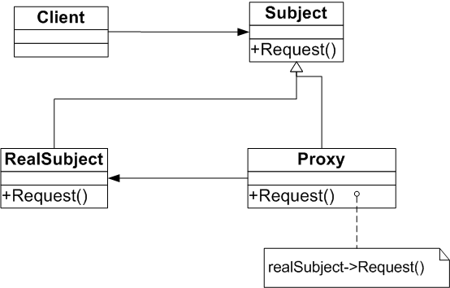
Proxy Pattern
“Provide a surrogate or placeholder for another object to control access to it”

Slide 7
Example using Proxy Pattern
AppCode
RemoteObjectProxy
Deals with communicationLogic
Caches static information
Remote
Object

Slide 8
When to use Proxy Pattern
A more sophisticated reference than a simple pointer is needed
Remote proxy provides local representative for object in different address space
Virtual proxy creates expensive objects on demand
Protection proxy controls access to original object
Smart pointers are needed to
manage object lifetime
loading object into memory when first referenced
lock management for synchronization

Slide 9
Consequences of using Proxy
Introduces a level of indirection in accessing objects
Indirection provides flexibility
Incurred cost on additional object and computations

Slide 10
Proxy Vs. Other Patterns
Adapter changes interface, Proxy provides the same interface
protection proxy implements subset of interface - may deny access to certain functions
Decorator adds functionality, proxy controls functionality

Slide 11
What if there are too many instances?

Slide 12
Flyweight Uses and Drawbacks
The Flyweight is used when a class has many instances, and they can all be controlled identically
A drawback of the Flyweight pattern is that once you’ve implemented it, single, logical instances of the class will not be able to behave independently from the other instances.

Slide 13
Flyweight Pattern

Slide 14
Flyweight Benefits
Reduce the number of object instances at runtime, saving memory
Centralizes states for many “virtual” objects into a single location

Slide 15
What if I don’t know which object should handle a request?

Slide 16
Chain of Responsibility

Slide 17
Chain of Responsibility Benefits
Decouples the sender of the request and its receivers
Simplifies your object because it doesn’t have to know the chain’s structure and keep direct references to its members
Allows you to add or remove responsibilities dynamically by changing the members or order of the chain

Slide 18
Chain of Responsibility Uses and Drawback
Commonly used in windows systems to handle events likes mouse clicks and keyboard events
Execution of the request isn’t guaranteed; it may fall off the end of the chain if no object handles it (this can be an advantage or disadvantage)
Can be hard to observe the runtime characteristics and debug

Slide 19
What if I need to remember where I am in the game?

Slide 20
Memento Pattern

Slide 21
Memento Benefits
Keeping the saved state external from the key object helps to maintain cohesion
Keeps the key object’s data encapsulated
Provides easy-to-implement recovery capability

Slide 22
Memento Uses and Drawbacks
The Memento is used to save state
A drawback to using Memento is that saving and restoring state can be time consuming
In java systems, consider using Serialization to save a system’s state

